Slide 1

Boosting Your Enemy While Shooting Your Friends
Subtitle: Decolonizing Development for a Sovereign African Future
Presenter: Judson Singer, AI-Powered Innovation Expert, Tharaka Invention Academy
Date: September 23, 2025
Venue: Chuka University

Slide 2

Beloved kenyan proverb

Slide 3
The Innovation Imperative: A Fork in the Road
Africa’s Persistent Innovation Gap – limited access to tools, training, and ecosystem support.
Dominant Western models – competitive, individualistic, extractive.
Marginalization of Indigenous Knowledge – dismissed as illegitimate.
Consequences – disconnect from local realities, dependency, stalled community innovation.
Strategic Vacuum – colonial legacies designed dependence, not creation.

Slide 4
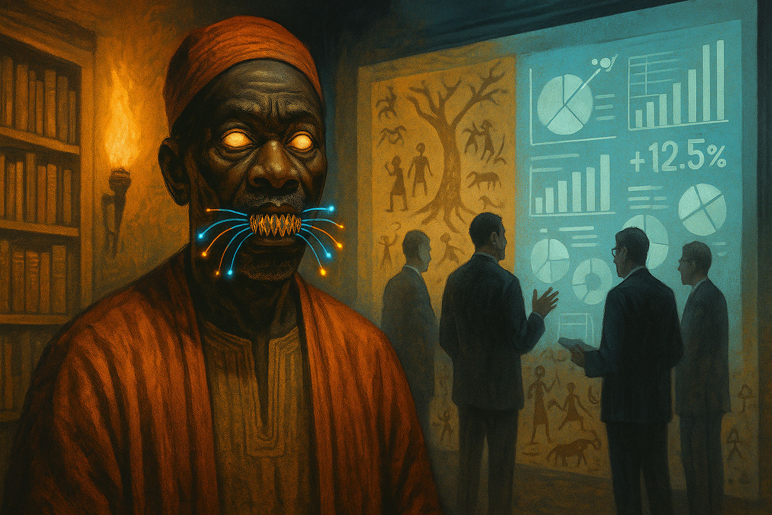
A Fork in the Road

Slide 5

TIA’s Foundational Stance: Decolonizing Innovation
Genesis: Founded 2021 by Prof. Judson "Oku" Singer in Marimanti, Kenya.
Core Philosophy: Rejects colonial epistemological pillars: (Eurocentrism, Classism, Objectivity, Knowledge Justifies Role as Overlords, Linguistic Domination Erases Local Knowledge Systems, Religion as Moral Justification, One Road to Progress).
African Pillars: Accessibility, Integration, Sovereignty.
Community-Based Organization ensures flexibility and cultural rootedness.

Slide 6
African Cosmology as Epistemology: A New Compass for Innovation
African Integrative worldview emphasizing harmony, community, and interconnectedness.
The Zulu or Shona notion of Ubuntu – communal identity and relationality.
Egyptian Ma’at – ethical balance, truth, and cosmic order.
Animism - Ancestral Guidance – intergenerational accountability and respect for natural world.
Among the Ashanti, the king’s duty to uphold balance (Asase Yaa and Nyame principles.
Among the Igbo, the Earth goddess Ala governs morality and balance, punishing injustice and pollution.
Among the Yoruba, the concept of ìwà pẹ̀lè links truth, justice, and harmony with cosmic order

Slide 7

African Cosmology as Epistemology

Slide 8
The TIA Curriculum Model: AI Meets Ancestral Ethics
‘Innovate Now’ Suite – modular, AI-enhanced, self-paced curriculum.
AI as a strategic enhancement – text generation, data visualization, automation.
Custom AI Coach – personalized GPT guiding learners in innovation.
Ethical Layer – reflection rooted in African cosmology.
Capstone Projects – locally relevant, ethically grounded.

Slide 9
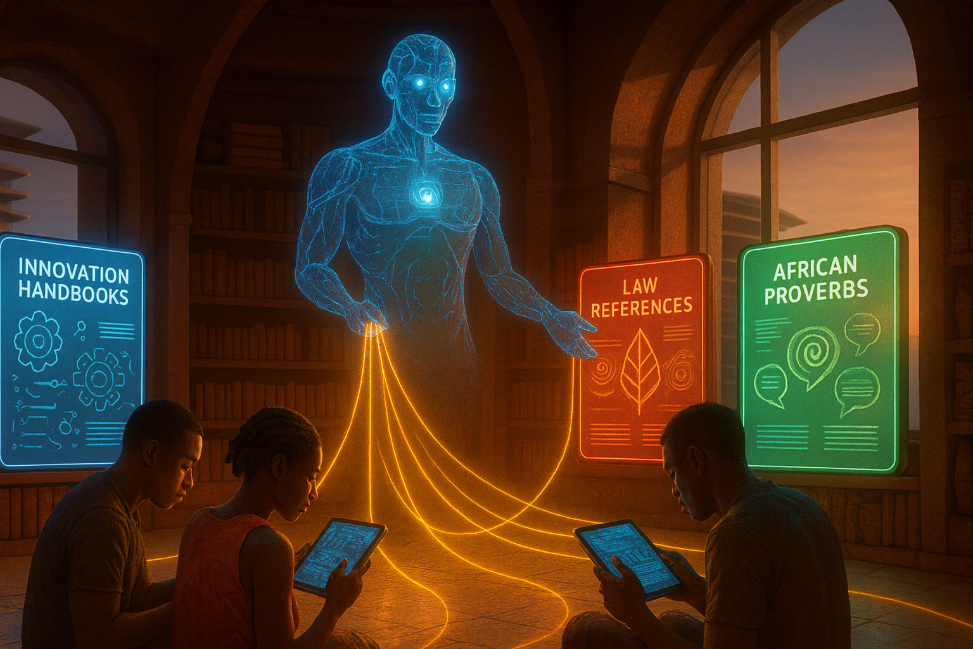
Custom AI Coach

Slide 10
Community-Centered Practice: Innovation as Service
Innovation as Service – solving real community needs.
Projects – solar dehydrators, water purification, AI agri-advisory tools.
Community Consultation – elders and artisans as collaborators.
Protection Model – local attribution, shared licensing (CERN-OHL-S).
Regenerative Learning – graduates lead workshops and ventures.

Slide 11
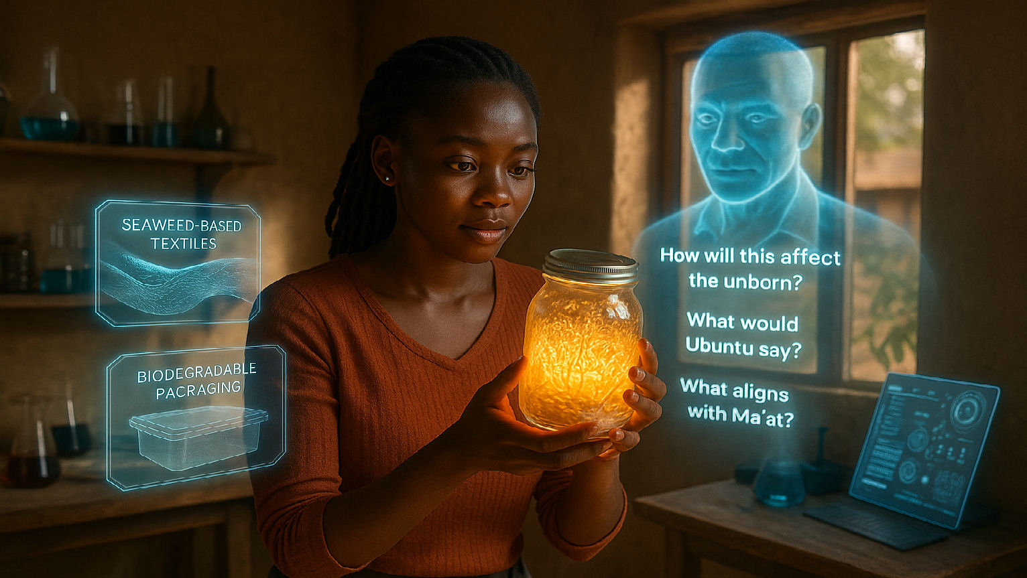
Innovation as Service

Slide 12
SDG Alignment & Policy Relevance: Beyond Aspiration
SDG 4 – quality education through cultural relevance.
SDG 8 – dignified work via community-rooted enterprises.
SDG 9 – inclusive infrastructure and innovation.
SDG 10 – reducing inequality, validating indigenous knowledge.
Policy Call – integrate cosmology-based innovation in curricula.

Slide 13

I am your innovation coach

Slide 14
The Long Game of Sovereignty: Design & Future
Beyond Mimicry – reclaim intellectual dignity and cultural wisdom.
Design Philosophy – reject extractive IP and planned obsolescence. (i.e. innovation should empower and enrich the community that gives rise to it, not extract from it.)
Commitment to Durability – repairability, modularity, local fabrication.
Pan-African Vision – local hubs, diaspora connection.
Agenda 2063 – prototype for people-driven development.

Slide 15
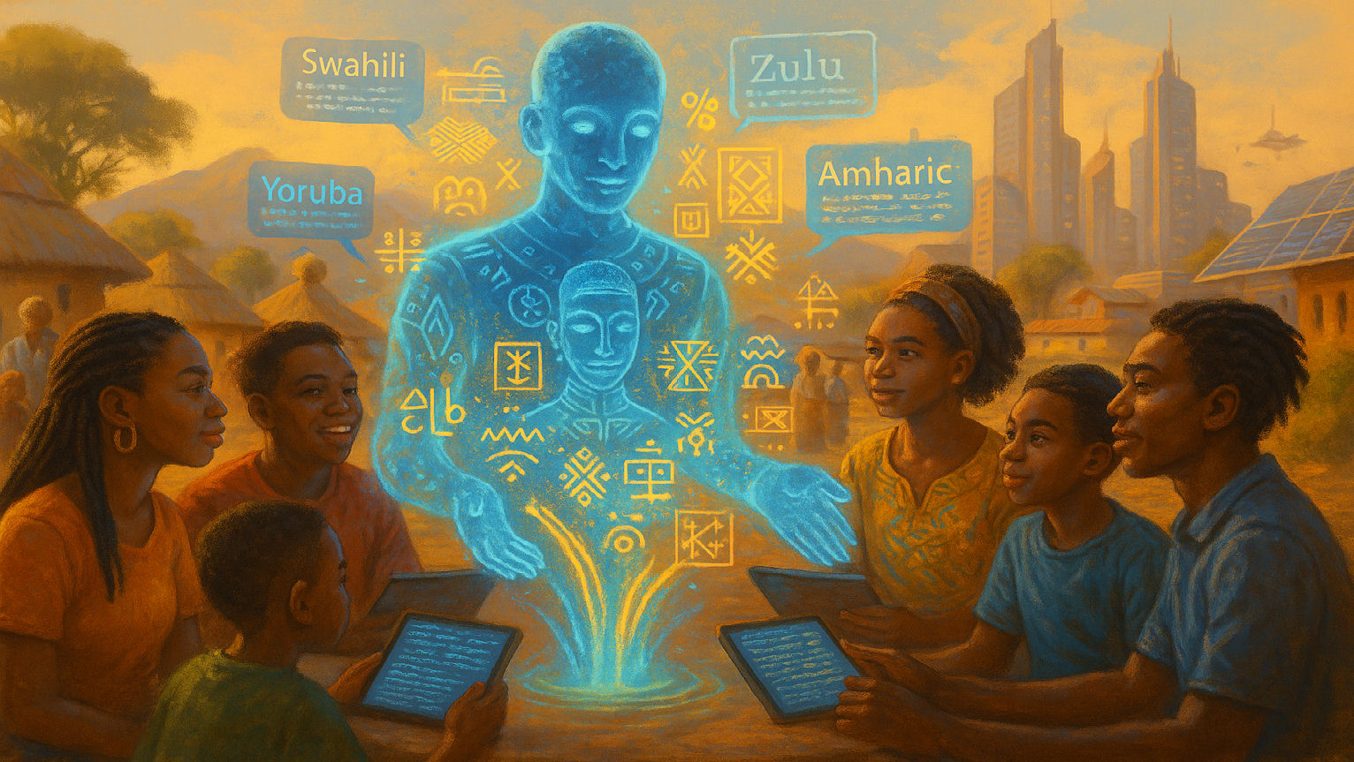
The Long Game of Sovereignty

Slide 16
Call to Action: Investing in a Sovereign Future
For Academics – engage indigenous epistemologies, collaborate on research.
For Business Leaders – partner with grassroots innovators, support ethical AI.
Champion repairability, open hardware, and technological sovereignty.
Innovation’s true measure: its power to restore, connect, and uplift.

Slide 17
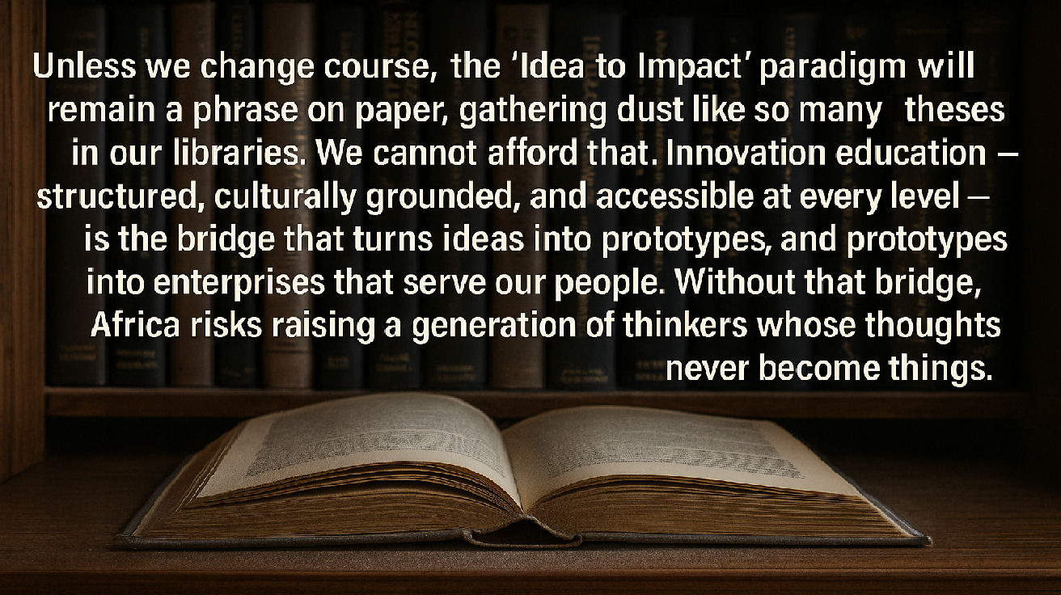
Closing thought

Slide 18
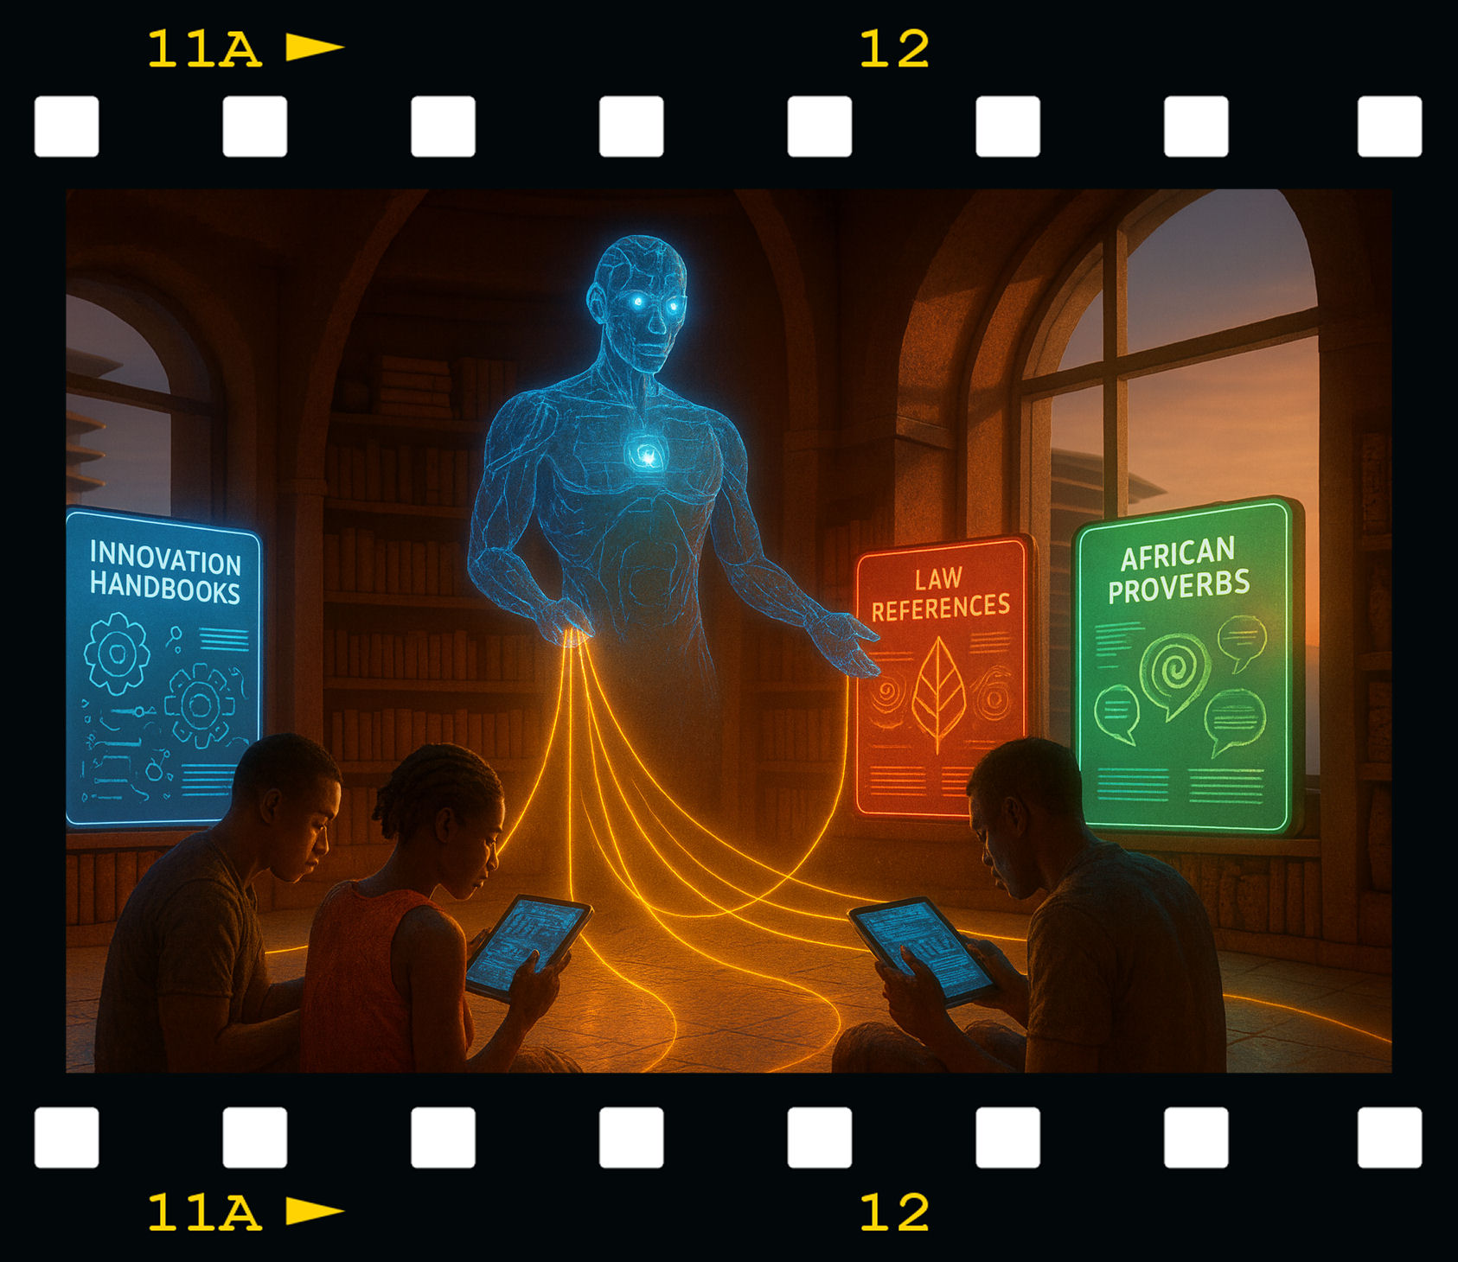

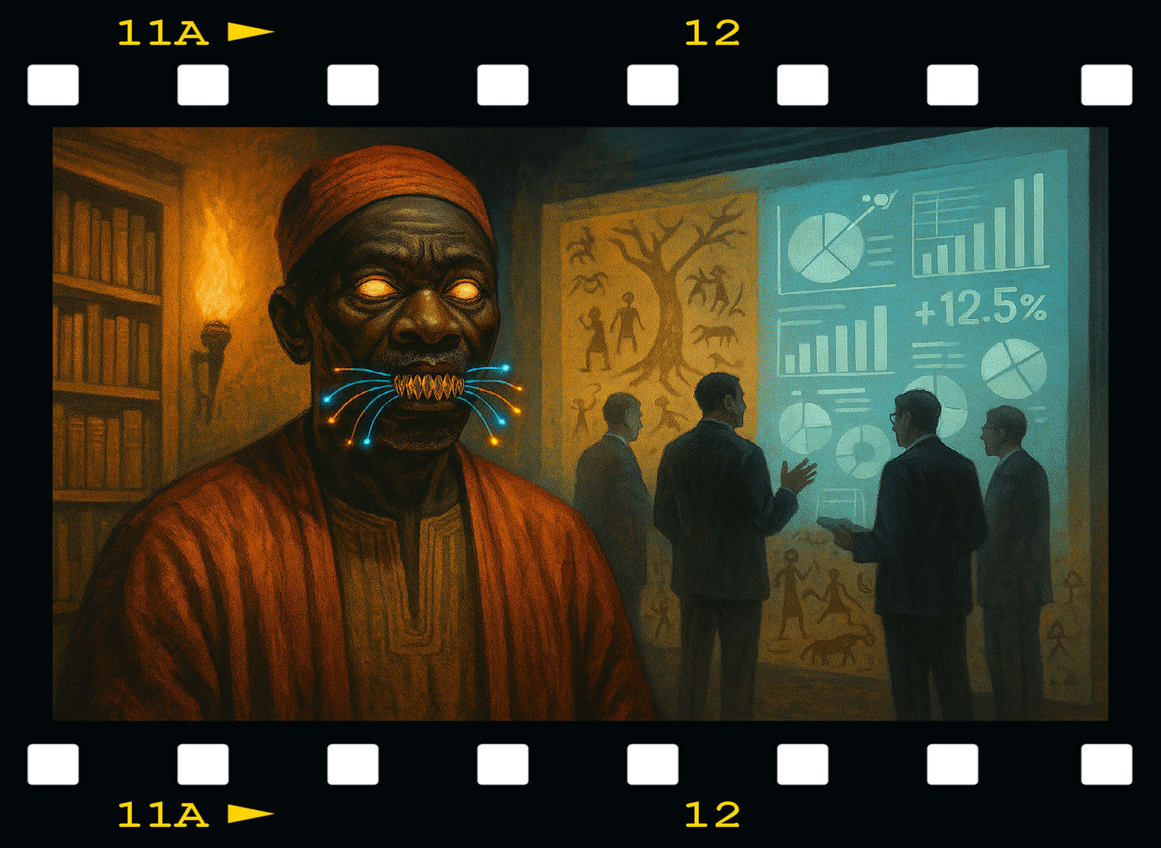
Thank You / Q&A
Contact: Prof. Singer, Director, Tharaka Invention Academy
profsinger@inventionschool.tech
‘By uniting ancestral wisdom with AI, we cultivate a sovereign African future.’
Enjoy the film “Enjoy Boosting Your Enemy While Shooting Your Friends” at
inventionschool.tech/keynote2025

